Slide 1
Chapter 11 Review
Religion and Reform (1800 – 1860)

Slide 2
Individualism: The Ethic of the Middle Class
Ralph Waldo Emerson and Transcendentalism:
Transcendentalism:
Every person possesses an inner light that can illuminate the highest truth and put him/her in direct touch with God
Ralph Waldo Emerson:
“Self-Reliance”

Slide 3
Individualism: The Ethic of the Middle Class Cont.
Emerson’s Literary Influence:
Henry David Thoreau:
Walden – Thoreau lived alone in nature for 2 years
Civil Disobedience – urged individuals to resist unjust laws
Margaret Fuller:
Argued for women’s social independence
Walt Whitman:
Leaves of Grass – focus on the individual

Slide 4
Rural Communalism and Urban Popular Culture
Utopias:
Societies that sought to achieve perfection
The Utopian Impulse:
Shakers:
Founded by Ann Lee
Advocated celibacy, equal rights for women
Oneida – “Free love”, sought to achieve perfection
Silverware production

Slide 5
Rural Communalism and Urban Popular Culture
Joseph Smith and the Mormon Experience:
Mormons (Church of Jesus Christ of Latter Day Saints)
Smith and his brother were murdered
Brigham Young led the Mormons to Utah

Slide 6
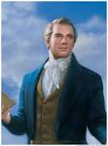

Slide 7
Rural Communalism and Urban Popular Culture
Urban Popular Culture:
Minstrel Shows:
White actors used blackface in shows that promoted racism and stereotypes
“Jim Crow” was a major character

Slide 8
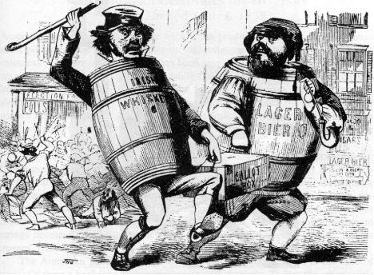
Rural Communalism and Urban Popular Culture
Nativist Movements:
Distain for immigrants
Called for an end to immigration
Aimed mostly at Irish (Catholics) who tended to vote Democrat

Slide 9
Abolitionism
Black Social Thought: Uplift, Race Equality, and Rebellion:
David Walker:
An Appeal… to the Colored Citizens of the World
Advocated violence to end slavery
Nat Turner’s Rebellion (1831):
Claimed to have revelations from Jesus
Rebellion in VA that killed 55 whites
60 blacks, including Turner, were killed in retaliation
As with all rebellions, slave laws became more harsh

Slide 10
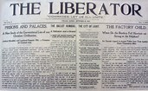
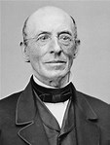
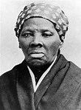
Abolitionism
Evangelical Abolitionism:
***William Lloyd Garrison:***
Radical abolitionist (for his time)
Published The Liberator – immediate and uncompensated end to slavery
The American Anti-Slavery Society:
Founded by Garrison and Theodore Weld
Helped show the violence of slavery
Underground RR:
1,000 slaves a year – Harriet Tubman

Slide 11
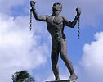
Abolitionism
Opposition and Internal Conflict:
Abolitionists were few in number
Many in the North benefitted from slavery (textile manufacturers, hog farmers)
Amalgamation:
Many whites opposed the intermarriage of whites and blacks

Slide 12
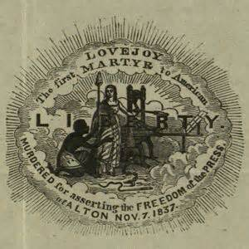
Abolitionism
Elijah Lovejoy:
Murdered in Illinois, outspoken abolitionist and editor of newspaper
Gag Rule – All anti-slavery petitions in the House would not be discussed; later overturned by John Q. Adams
The abolitionist movement split over
women’s rights
Garrison’s American Anti-Slavery Society
supported women’s rights

Slide 13
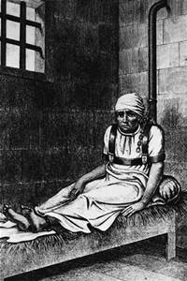
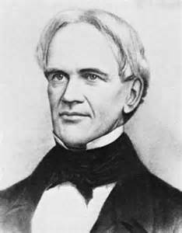
The Women’s Rights Movement
Women played a large role in trying to reform American Society
Origins of the Women’s Movement:
Separate Sphere – expectation that women had different roles in society
Dorothea Dix – mental health reform
Horace Mann – “Father of Education”
Tax-Supported elementary schools
Schools in the South and West were inferior to the North

Slide 14
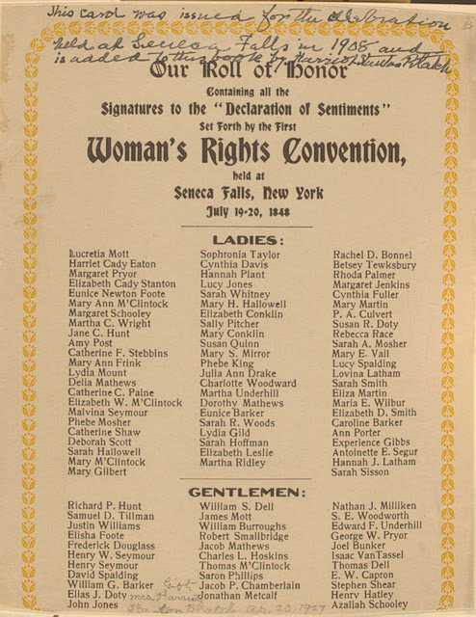
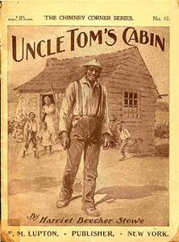
The Women’s Rights Movement
From Black Rights to Women’s Rights:
Uncle Tom’s Cabin:
Harriet Beecher Stowe – portrayed the evils of slavery
Seneca Falls Convention:
Elizabeth Cady Stanton and Lucretia Mott
Declaration of Sentiments – “All men and women
are created equal”

Slide 15
THE RECAP
Transcendentalism
Henry David Thoreau
Minstrel Shows
Nativism
Nat Turner’s Rebellion
William Lloyd Garrison
Abolitionist Movement split over women’s rights
Dorothea Dix
Seneca Falls Convention

